Slide 1






INVENTORY MANAGEMENT SYSTEM
TEAM CREW -X
B .S. Aarya
Hariharan.K
Soorya.K
Sam Naveenkumar.V
Dhruv Swamy.R

Slide 2


PROBLEM STATEMENT
Inefficient inventory management system in laboratory faces several challenges, including stockouts, overstocking, theft, and difficulty in tracking items.
Waste of time, component loss, and reduced productivity for researchers and laboratory staff

Slide 3


IDEA APPROACH
•To overcome the problems in laboratories caused by stockouts, overstocking and loss of raw materials using smart inventory management system.
•To provide a real-time visibility and automate the inventory tracking to replenish the process.
•
•To develop an advanced laboratory inventory management system that leverages mordern technologies.

Slide 4

WHAT IS INVENTORY MANAGEMENT SYSTEM AND WHY ?
An inventory management system is software that help university to track, control, and optimize their inventory levels and operations, leading to improved efficiency, reduced costs, and better customer satisfaction.
"We're developing an inventory management system tailored for university laboratories. Our solution involves a vending machine equipped with components. Students use a barcode scanner to access items, which are dispensed by an Arduino-controlled servo motor. Each transaction is recorded, ensuring accurate inventory tracking and management."

Slide 5

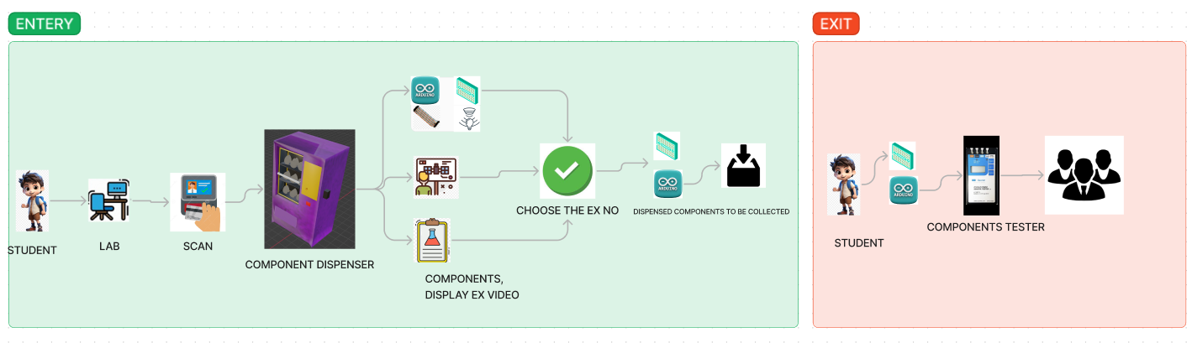
FLOW DIAGRAM

Slide 6
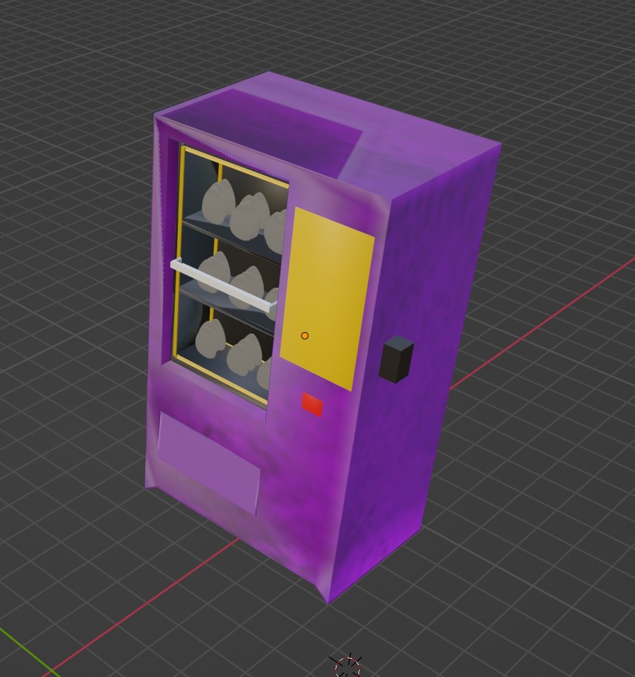
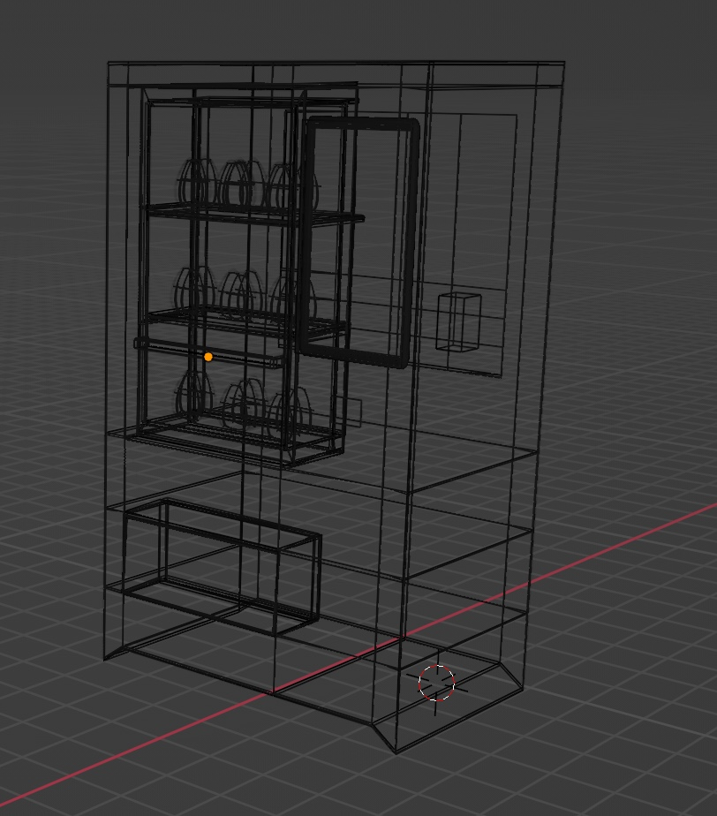
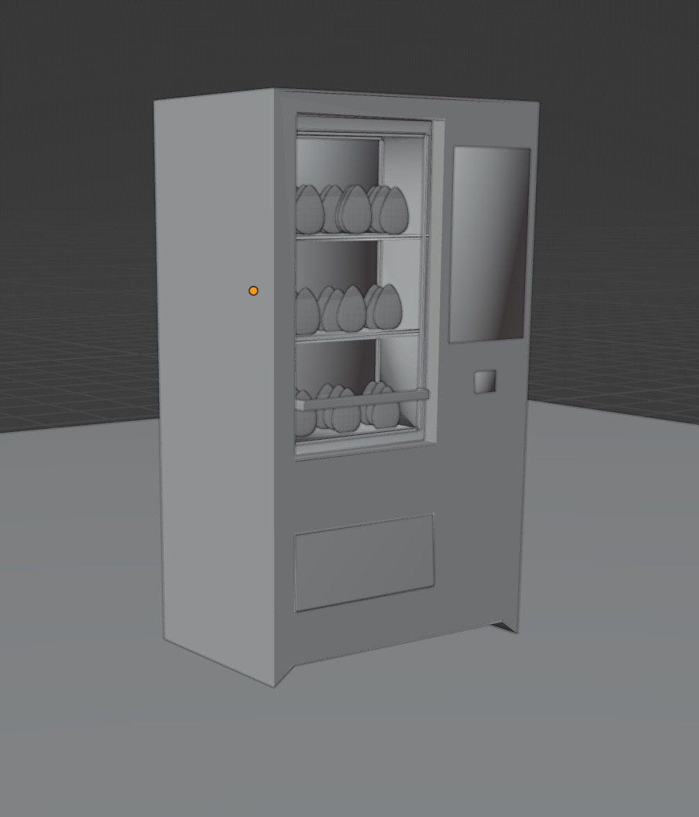


3D MODEL OF OUR PROJECT

Slide 7
BENEFITS
Implementing this project results in a more efficient, accountable, and cost-effective management of laboratory resources, benefiting both students and the university as a whole
Efficiency: Streamlines component distribution, saving time and effort.
Inventory Accuracy: Provides real-time tracking to minimize discrepancies.
Accountability: Records student usage, promoting responsible resource management.
Security: Reduces theft and loss through controlled access and tracking.
Data Insights: Enables analysis of usage patterns for optimized management.
Convenience: Offers students easy access to components outside regular hours.
Cost Savings: Prevents overuse and reduces administrative overhead, leading to savings.
Product 2

Slide 8
COMPONENTS EMPLOYED
RFID Tags: Used to tag individual components for identification and tracking purposes.
Barcode Scanner: Enables students to access components by scanning their IDs or barcodes.
Arduino Microcontroller: Controls the operation of the vending machine, including interfacing with RFID tags, barcode scanner, servo motor, and push buttons.
Servo Motor: Drives the mechanical mechanism responsible for dispensing the components.
Push Buttons: Provide additional control inputs for user interaction with the vending machine.
Inventory Management Software: Manages inventory levels, tracks transactions, and provides data insights for optimized management.

